Slide 1

The Mathematics of Reinforcement Learning and its Applications
Aadam Ul Haq

Slide 2
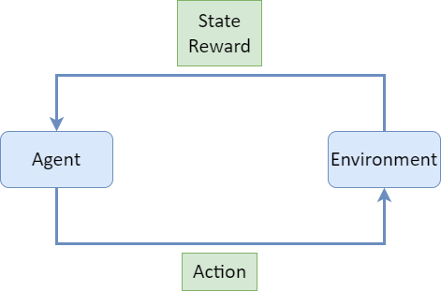
What is Reinforcement Learning?
Reinforcement learning studies how an agent can learn to behave via feedback and interaction with an environment to maximise rewards.
There is no answer, but a reinforcement agent decides what to do to perform the task from past experiences.

Slide 3
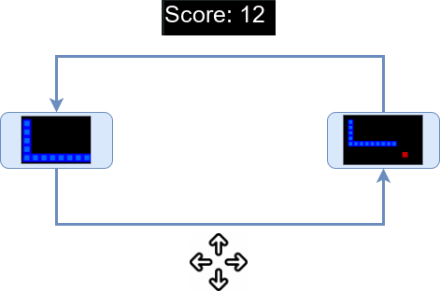
What are the uses of Reinforcement Learning?
Robotics
Autonomous Vehicles and Traffic Control
Chatbots (NLP)
Healthcare
Video Games

Slide 4
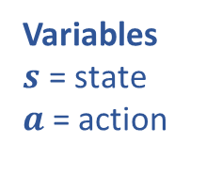
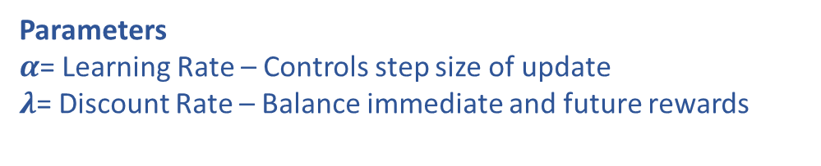
Bellman Equation (Q-Learning)
$$Q_{new}(s, a) = Q(s, a) + α[R(s, a) + λ \max_{}{[Q(s′, a)]}− Q(s, a)]$$
Updated Q value
Current Q value
Immediate reward after taking action
Maximum Q-Value among all possible actions in next state
Current Q value
Variables
$s$ = state
$a$ = action
Parameters
$α$= Learning Rate – Controls step size of update
$λ$= Discount Rate – Balance immediate and future rewards

Slide 5
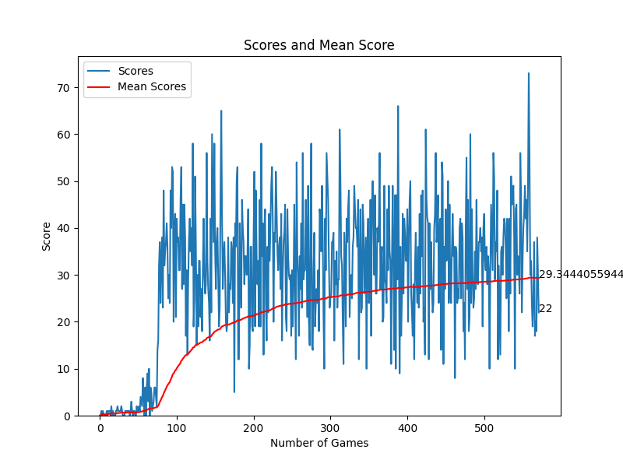
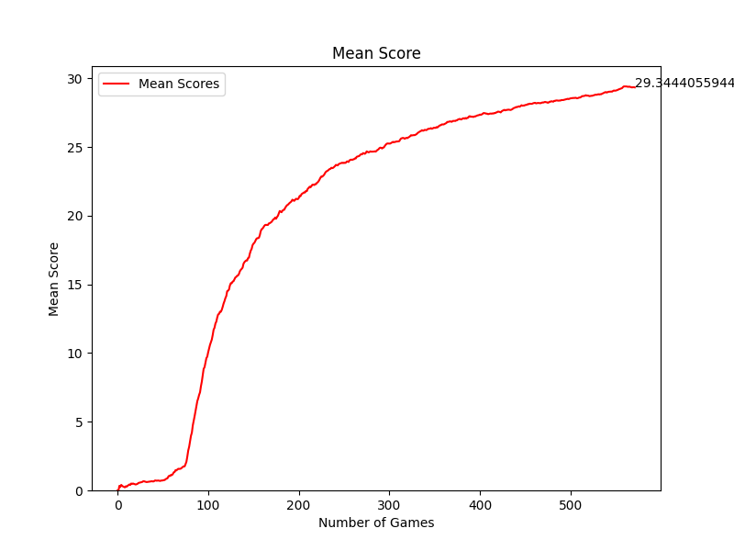
Exploitation vs Exploration
After 10 Games
After 50 Games
After 150 Games (125% speed)

Slide 6
Thank You!

